Slide 1
CSE 4128 Image Processing and Computer Vision Laboratory
Dr. Sk. Md. Masudul Ahsan
Professor
Dept. of CSE, KUET
Dipannita Biswas
Lecturer
Dept. of CSE, KUET

Slide 2
Course Outlines
WEEK 1 | Convolution
WEEK 2 | Segmentation applying edge detection and thresholding
WEEK 3 | Histogram equalization and matching
WEEK 4 | Frequency Domain Filtering
WEEK 5 | Region Descriptors
WEEK 6 | Project Showcasing and Labtest

Slide 3
Week 1
Topic: Convolution

Slide 4
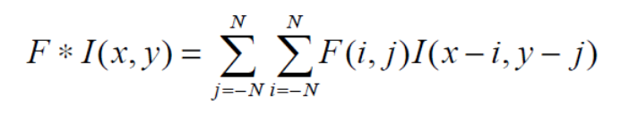
Convolution
Convolution is an operation performed on two functions to produce a third function.
In image processing, convolution is the process of transforming an image by applying a kernel over each pixel and its local neighbors across the entire image.
The convolution operation applied on Image I(x,y) using a kernel F is given by

Slide 5
Convolution
1 | 1 | 0 | 1 | 0
0 | 0 | 1 | 0 | 0
0 | 1 | 0 | 0 | 1
1 | 0 | 1 | 0 | 1
0 | 1 | 1 | 1 | 0
0 | 0 | 0 | 0 | 0
0 | 0 | 0 | 0 | 0
0 | 0 | 0 | 0 | 0
0 | 0 | 0 | 0 | 0
0 | 0 | 0 | 0 | 0
1 | 2 | 3
4 | 5 | 6
7 | 8 | 9
F
I
F * I(X,Y)

Slide 6
Convolution
Step 1
1X9 | 1X8 | 0X7 | 1 | 0
0X6 | 0X5 | 1X4 | 0 | 0
0X3 | 1X2 | 0X1 | 0 | 1
1 | 0 | 1 | 0 | 1
0 | 1 | 1 | 1 | 0
0 | 0 | 0 | 0 | 0
0 | 23 | 0 | 0 | 0
0 | 0 | 0 | 0 | 0
0 | 0 | 0 | 0 | 0
0 | 0 | 0 | 0 | 0
1 | 2 | 3
4 | 5 | 6
7 | 8 | 9
F
I(X,Y)
F * I(X,Y)

Slide 7
Convolution
Step 2
1 | 1X9 | 0X8 | 1X7 | 0
0 | 0X6 | 1X5 | 0X4 | 0
0 | 1X3 | 0X2 | 0X1 | 1
1 | 0 | 1 | 0 | 1
0 | 1 | 1 | 1 | 0
0 | 0 | 0 | 0 | 0
0 | 23 | 24 | 0 | 0
0 | 0 | 0 | 0 | 0
0 | 0 | 0 | 0 | 0
0 | 0 | 0 | 0 | 0
1 | 2 | 3
4 | 5 | 6
7 | 8 | 9
F
I(X,Y)
F * I(X,Y)

Slide 8
Convolution
Step 3
1 | 1 | 0 | 1 | 0
0 | 0 | 1 | 0 | 0
0 | 1 | 0 | 0 | 1
1 | 0 | 1 | 0 | 1
0 | 1 | 1 | 1 | 0
0 | 0 | 0 | 0 | 0
0 | 23 | 24 | 15 | 0
0 | 0 | 0 | 0 | 0
0 | 0 | 0 | 0 | 0
0 | 0 | 0 | 0 | 0
1 | 2 | 3
4 | 5 | 6
7 | 8 | 9
F
I(X,Y)
F * I(X,Y)

Slide 9
Convolution
Step 4
1 | 1 | 0 | 1 | 0
0 | 0 | 1 | 0 | 0
0 | 1 | 0 | 0 | 1
1 | 0 | 1 | 0 | 1
0 | 1 | 1 | 1 | 0
0 | 0 | 0 | 0 | 0
0 | 23 | 24 | 15 | 0
0 | 16 | 0 | 0 | 0
0 | 0 | 0 | 0 | 0
0 | 0 | 0 | 0 | 0
1 | 2 | 3
4 | 5 | 6
7 | 8 | 9
F
I(X,Y)
F * I(X,Y)

Slide 10
Convolution
Step 5
1 | 1 | 0 | 1 | 0
0 | 0 | 1 | 0 | 0
0 | 1 | 0 | 0 | 1
1 | 0 | 1 | 0 | 1
0 | 1 | 1 | 1 | 0
0 | 0 | 0 | 0 | 0
0 | 23 | 24 | 15 | 0
0 | 16 | 16 | 0 | 0
0 | 0 | 0 | 0 | 0
0 | 0 | 0 | 0 | 0
1 | 2 | 3
4 | 5 | 6
7 | 8 | 9
F
I(X,Y)
F * I(X,Y)

Slide 11
Convolution
Step 6
1 | 1 | 0 | 1 | 0
0 | 0 | 1 | 0 | 0
0 | 1 | 0 | 0 | 1
1 | 0 | 1 | 0 | 1
0 | 1 | 1 | 1 | 0
0 | 0 | 0 | 0 | 0
0 | 23 | 24 | 15 | 0
0 | 16 | 16 | 17 | 0
0 | 0 | 0 | 0 | 0
0 | 0 | 0 | 0 | 0
1 | 2 | 3
4 | 5 | 6
7 | 8 | 9
F
I(X,Y)
F * I(X,Y)

Slide 12
Convolution
Step 7
1 | 1 | 0 | 1 | 0
0 | 0 | 1 | 0 | 0
0 | 1 | 0 | 0 | 1
1 | 0 | 1 | 0 | 1
0 | 1 | 1 | 1 | 0
0 | 0 | 0 | 0 | 0
0 | 23 | 24 | 15 | 0
0 | 16 | 16 | 17 | 0
0 | 21 | 0 | 0 | 0
0 | 0 | 0 | 0 | 0
1 | 2 | 3
4 | 5 | 6
7 | 8 | 9
F
I(X,Y)
F * I(X,Y)

Slide 13
Convolution
Step 8
1 | 1 | 0 | 1 | 0
0 | 0 | 1 | 0 | 0
0 | 1 | 0 | 0 | 1
1 | 0 | 1 | 0 | 1
0 | 1 | 1 | 1 | 0
0 | 0 | 0 | 0 | 0
0 | 23 | 24 | 15 | 0
0 | 16 | 16 | 17 | 0
0 | 21 | 20 | 0 | 0
0 | 0 | 0 | 0 | 0
1 | 2 | 3
4 | 5 | 6
7 | 8 | 9
F
I(X,Y)
F * I(X,Y)

Slide 14
Convolution
Step 9
1 | 1 | 0 | 1 | 0
0 | 0 | 1 | 0 | 0
0 | 1 | 0 | 0 | 1
1 | 0 | 1 | 0 | 1
0 | 1 | 1 | 1 | 0
0 | 0 | 0 | 0 | 0
0 | 23 | 24 | 15 | 0
0 | 16 | 16 | 17 | 0
0 | 21 | 20 | 22 | 0
0 | 0 | 0 | 0 | 0
1 | 2 | 3
4 | 5 | 6
7 | 8 | 9
F
I(X,Y)
F * I(X,Y)

Slide 15
Python as Task Language
Ease of readability and ease of learning
Extensive libraries present, the majority are open source and free.
Generally slower than C++ in terms of raw performance but more user-friendly.
Libraries:
OpenCV (Open Source Computer Vision Library)
NumPy
Matplotlib
Notes:
(as C++ is syntactically complex and needs manual memory management).

Slide 16
OpenCV
OpenCV is faster
It also can perform certain computer vision-specific operations, like object detection, feature extraction, image segmentation, etc.
Integrates well with libraries like NumPy, scikit-learn, TensorFlow, and other computer vision and machine learning libraries.

Slide 17
Installation
Download Anaconda installer.
Installation link: https://docs.anaconda.com/anaconda/install/
OpenCV installation on Anaconda prompt:
pip install opencv-python
pip install opencv-contrib-python
For updating pip: python -m pip install --upgrade pip

Slide 18
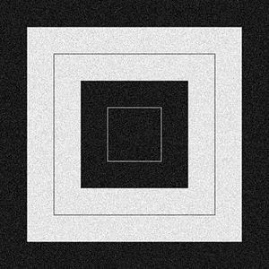
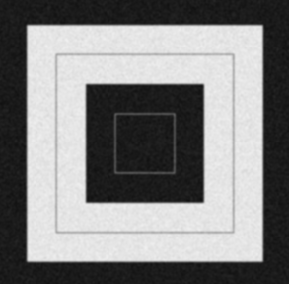
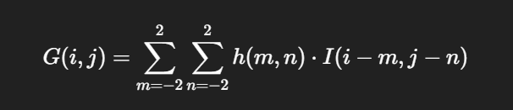
Classwork
Read the Image and Apply appropriate padding
Apply convolution on the padded image using the Given a 5x5 kernel with center at (2,2)
Normalize and crop the original size
Show output of each step
Input
0 1 2 1 0
1 3 5 3 1
2 5 9 5 2
1 3 5 3 1
0 1 2 1 0
Kernel =
Output

Slide 19
Classwork
Apply Prewitt operator using Convolution where the center of the kernel is at (0,0):
It works like as first order derivate and calculates the difference of pixel intensities in a edge region.
-1 | 0 | 1
-1 | 0 | 1
-1 | 0 | 1
-1 | -1 | -1
0 | 0 | 0
1 | 1 | 1
G_{x} will find the edges in the vertical direction
G_{y} will find edges in the horizontal direction

Slide 20
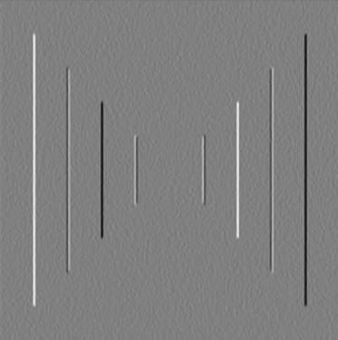

Classwork
Output of center at (1,1)
Input
Applying G_{x}
Applying G_{y}

Slide 21
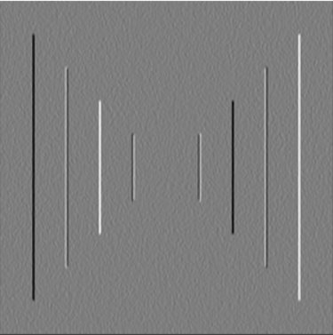

Classwork
Output of center at (0,0)
Input
Applying G_{x}
Applying G_{y}

Slide 22
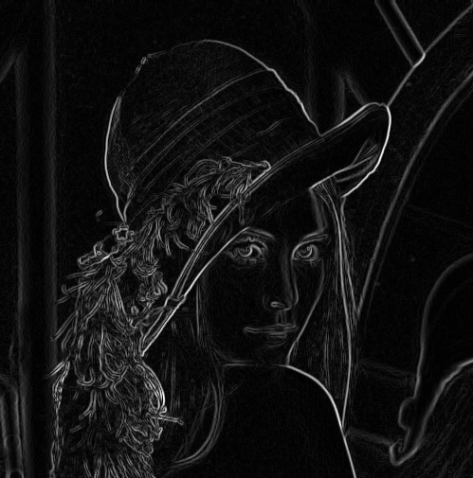
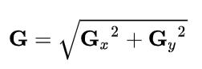
Gradient Magnitude

Slide 23
Assignment
Apply Convolution using both smoothing and sharpening kernels on a grayscale image and output the results,
Smoothing kernel is a gaussian filter of size 5 x sigma
b) Sharpening kernel is a gaussian derivative kernel of size 7 x sigma
2. Repeat the process for the Color image:
Take an RGB image and apply convolution with each kernel, separately on each channel.
Convert the RGB image to HSV mode and apply convolution with each kernel, separately on each channel of HSV space.
Observe the difference and discuss it in your report by showing and comparing the results.
Note: You can use library functions as required to do the tasks

Slide 24
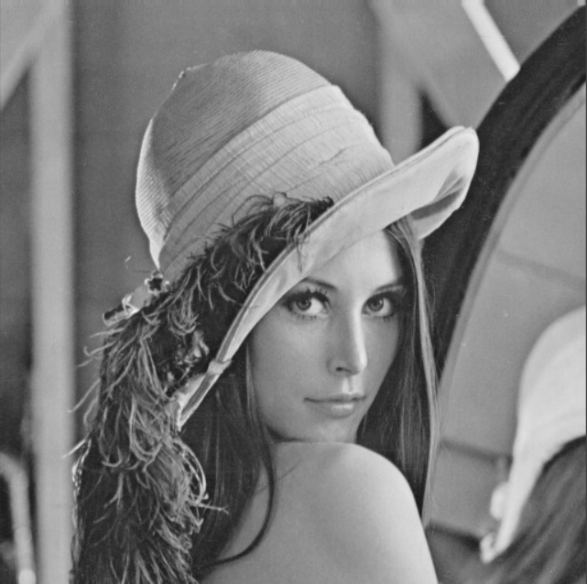
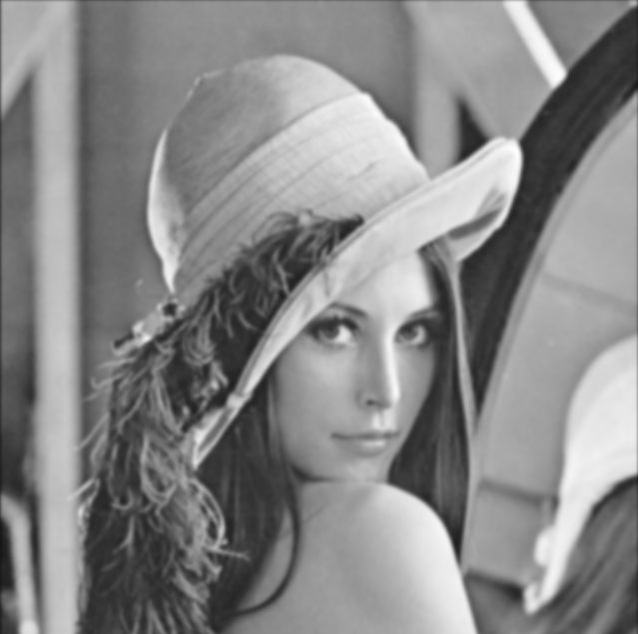
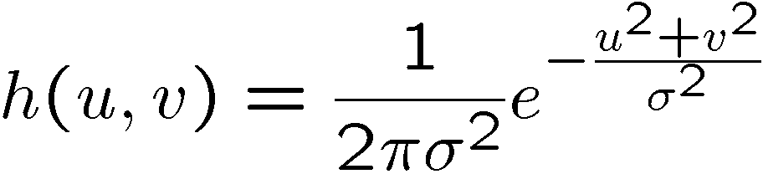
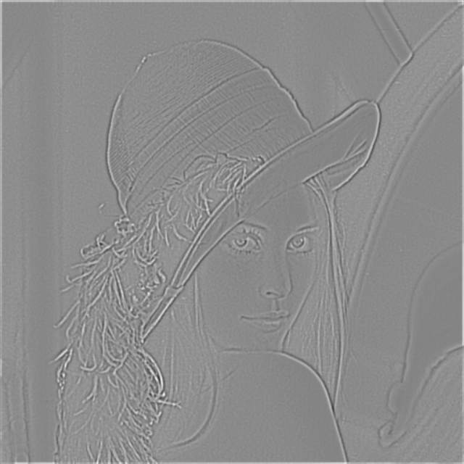
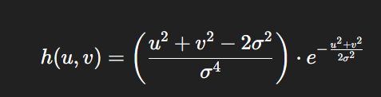
Sample Outputs
Input Image
Gaussian Smoothing Filter
2nd Order Partial Derivative
Gaussian Sharpening (LoG) Filter

Slide 25
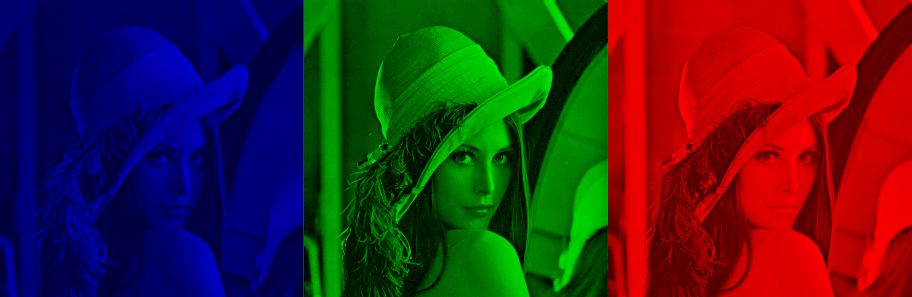
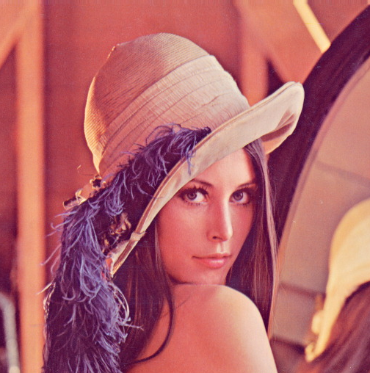
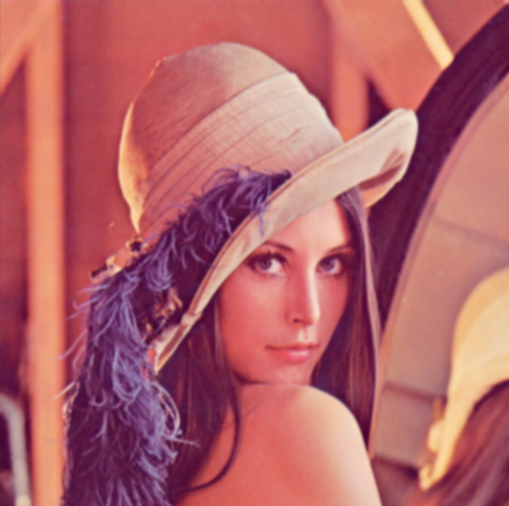
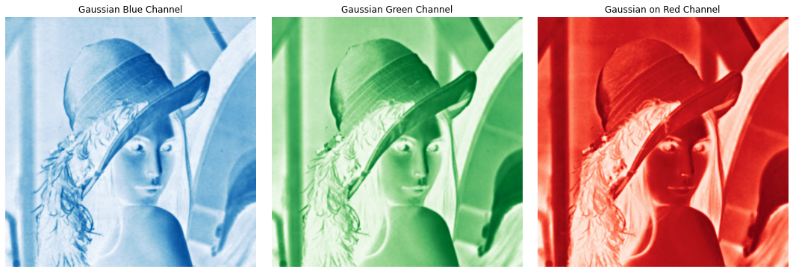
Image Splitting
Figure(Left to right): Blue, Green, Red Channel
Color image
in RGB space
Merged

Slide 26
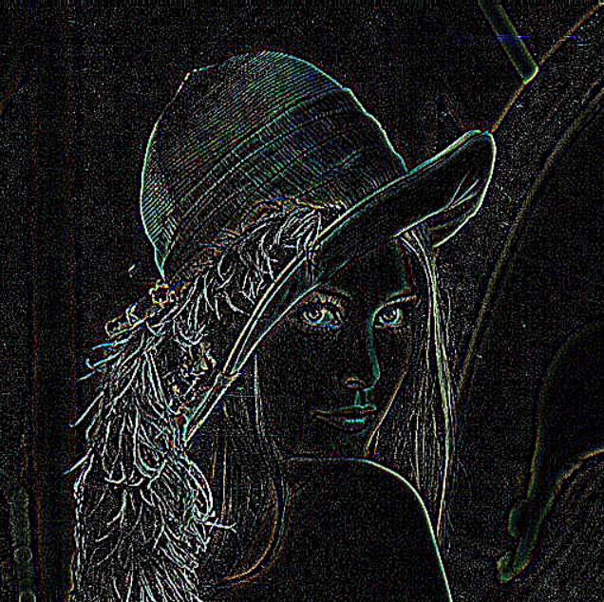
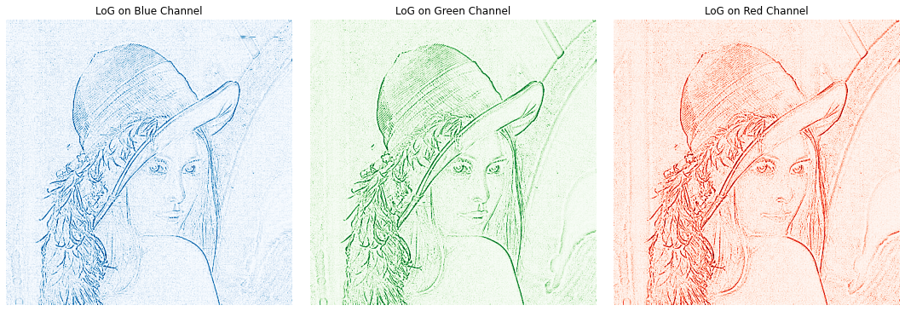
Split and LoG
Merged

Slide 27
Thank You

